Slide 1
SWEN Assignment 1
Chua Edwin – 1101387G
Marvin Koh – 1101137F
Leonard Choo – 1105342H

Slide 2
SDLC
Software Development Life Cycle
Consists of: Requirements Engineering, Analysis & Design, Implementation, Testing & Deployment

Slide 3
SDLC
3 Models:
Waterfall
Prototyping
Unified Process

Slide 4
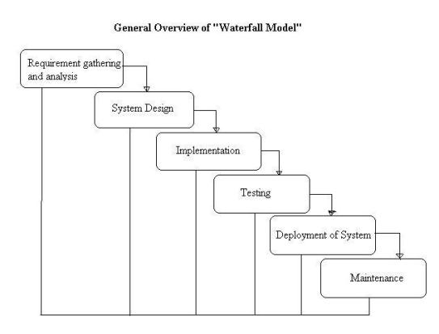
SDLC
Each of the phase must be completed fully before the next phase can begin in the waterfall model

Slide 5
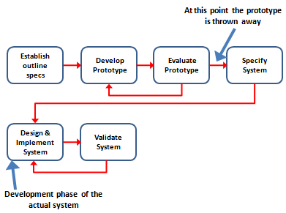
SDLC
Prototyping
Throwaway Prototyping:
Implements initial requirements
Shown to client and gather new specifications

Slide 6
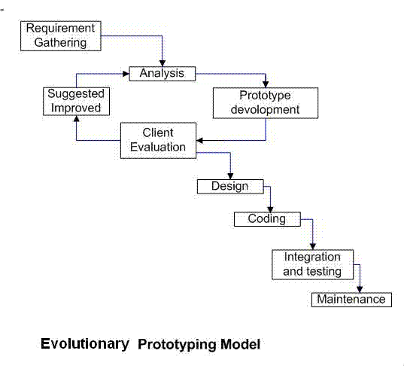
SDLC
Evolutionary Prototyping:
Develop initial system
Shown system to client & improved on over time until a complete system is done

Slide 7
SDLC
Unified Process
4 phases: Inception, Elaboration, Construction & Transition.

Slide 8
SDLC
Inception is a feasibility study to establish whether the proposed system is worthwhile
Elaboration is about getting a complete list of requirements, design architecture and also develop the project plan and the risk.
Construction is about developing the system
Transition is putting the system into use.

Slide 9
SDLC
Uses iteration to accommodate ongoing risk
Each phase can consist of one or more iterations.

Slide 10
Terms of Reference

Slide 11
Terms of Reference
Purpose: Develop a hotel management system for Delonix Regia to assist them in managing their customers and to boost their customer traffic.
Background: Good District but not doing well Existing website lacking in basic functions

Slide 12
Terms of Reference
Users: Customers & Tourists
Usage: Signing up for an account Reservation & cancelation of a room Hotel Information

Slide 13
Terms of Reference
Objectives
Technical: System online 24/7 Minimized server downtime – 2 Servers
1 main server and 1 independent server/back-up
Back-up server utilize when other server is being maintained/updated
User friendly system interface – Cater to non-IT savvy customers
Non Technical Conduct live meeting with Mr and Mrs Wang to update them on the progress of the hotel management system development process.
Conduct a requirement gathering meeting with Mr and Mrs Wang to obtain requirement requests

Slide 14
Terms of Reference
Scope:
Login System / Loyalty Program
Live Update: Allow users to: Check rooms availability Make bookings Check & Cancel bookings
Customer Compatibility

Slide 15
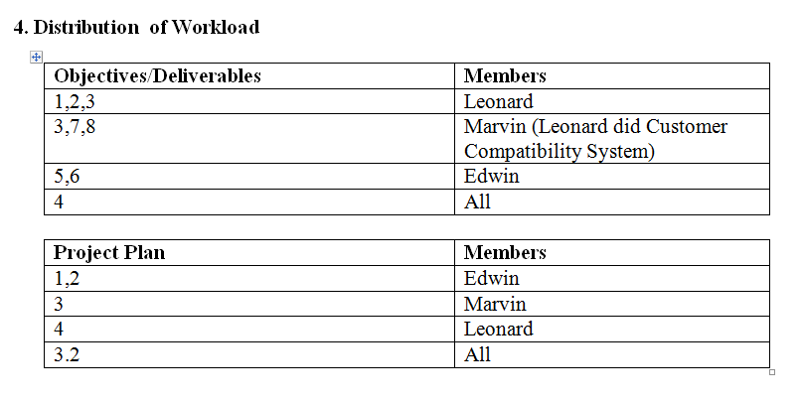
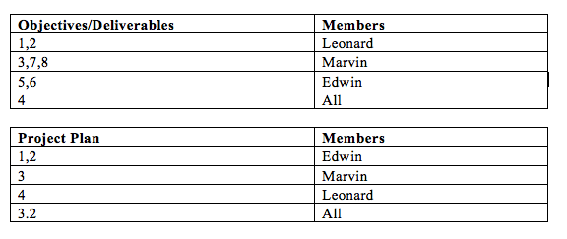
Terms of Reference
Workload Distribution

Slide 16
Terms of Reference
Constraints: Personal laptops not configured properly School Lab Opening hours – Usage of School workstations
Resources:
Hardware: Personal Laptops / School Workstations
Software:
Word Processing Software (E.g Microsoft Word)
Visual Studio 2010/2012
Web Broswer (E.g IE, Mozilla, Chrome)
SQL Server Management Studio
Online Cloud Storage (E.g Dropbox, Google Drive, Skydrive

Slide 17
Product Positioning in the Market/Company
Does not require a third-party booking system (e.g. Asiarooms.com, Expedia.com.sg, Zuji.com.sg)
Will have constant software updates/bug fixes in response to users’ feedback on the app – we aim to be a 5-star app that will not disappoint our user.

Slide 18
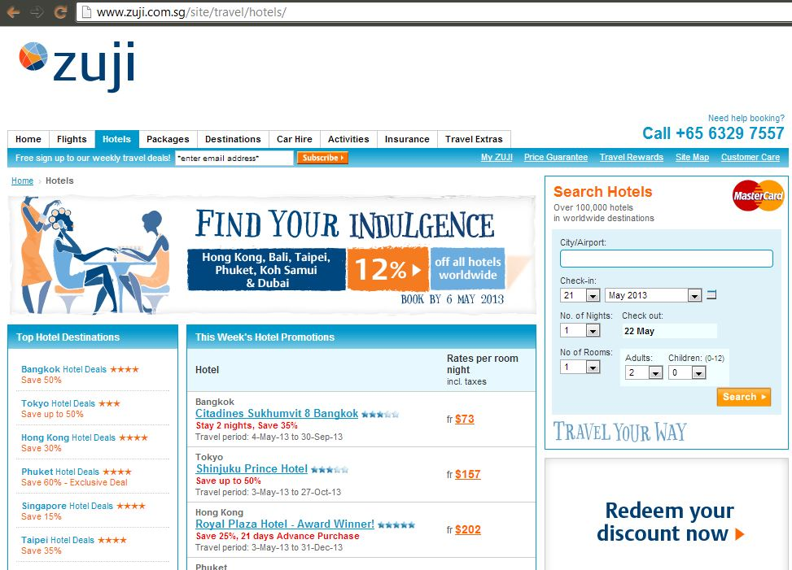

Slide 19
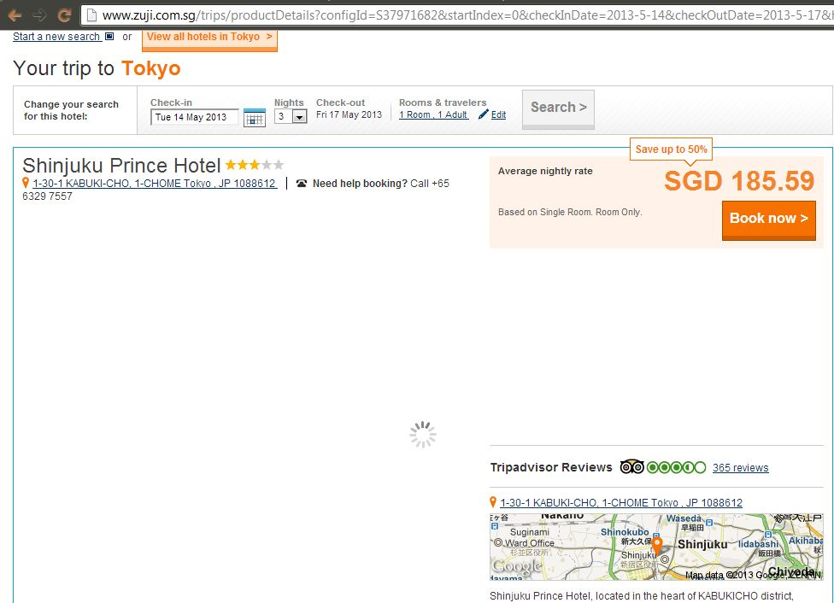

Slide 20
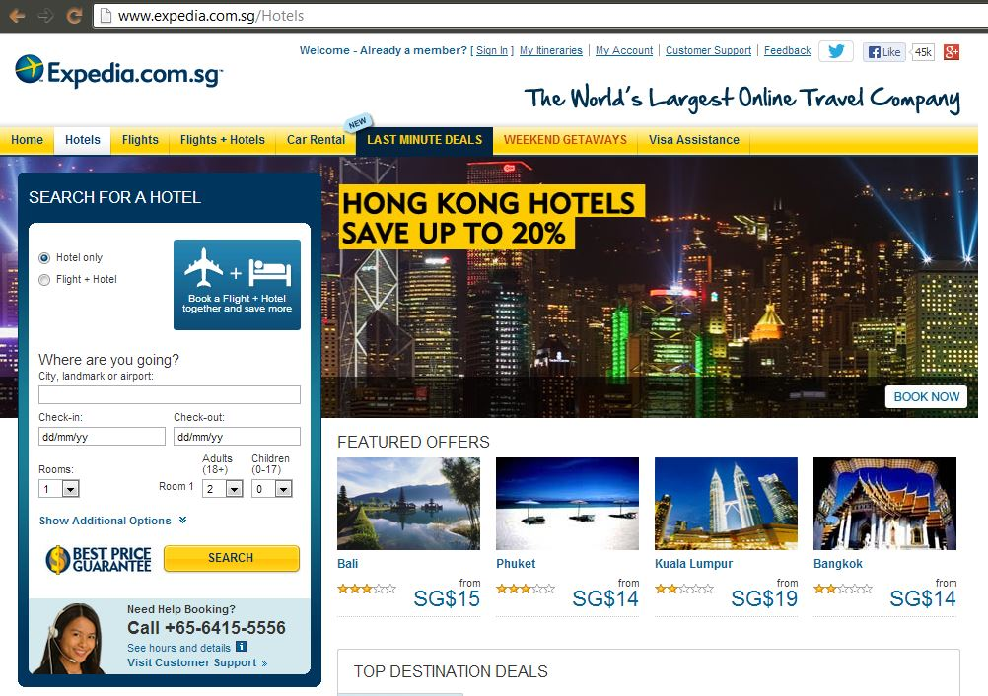

Slide 21
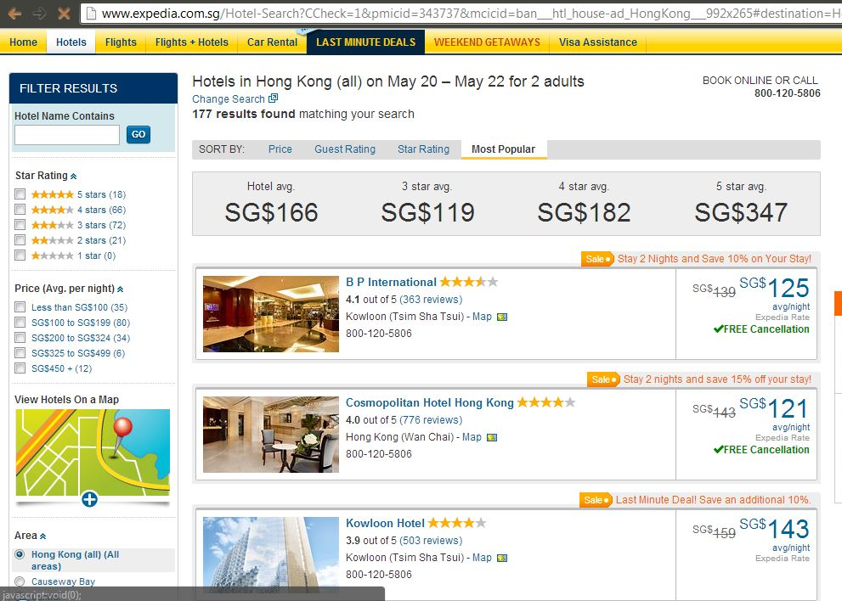

Slide 22
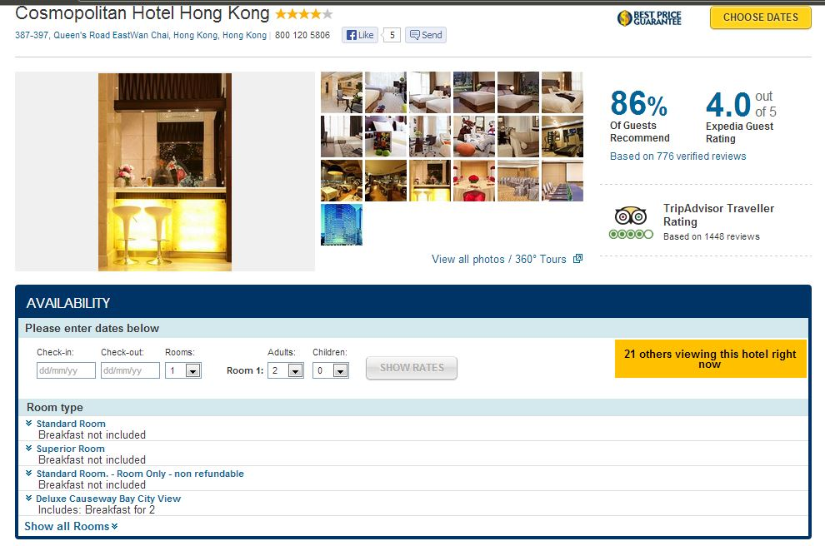
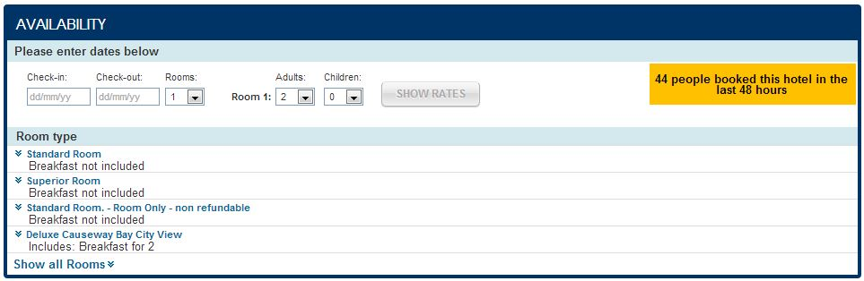

Slide 23
Project Plan

Slide 24
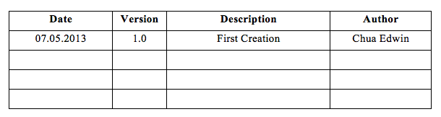
Project Plan
Revision History

Slide 25
Project Plan
Objectives & Scope
Develop a hotel management system for Delonix Regia
Features:
A login in & Loyalty program system for customers to create an account.
A live update system, where users are able to check the availability of the rooms, make bookings, check the booking status and cancel exisiting bookings.
Customer’s compatibility checking – Rooms will be offered to customers based on their budget and preferences.

Slide 26
Project Plan
Assumptions & Constraints:
A functioning website exist, but lacking in basic functions such as booking of rooms and more.
Any functions proposed is not final, as Mr and Mrs Wang have not decided on the final features that they want.
Constraints:
Personal Laptops not configured properly to SQL database.
Lab opening hours due to usage of school workstations.
Software only usable and available on School VDI.

Slide 27
Project Plan
Defintions & Acronyms
VDI – Virtual Desktop Infrastructure (Vmware)
SQL – Structured Query Language

Slide 28
Project Plan
Roles & Responsibilities
Live update – Marvin
Login System & Loyalty System – Edwin
Customer Compatibility – Leonard
Database and Features Integration - Everyone

Slide 29
Work Breakdown Structure
Delonix Regia Hotel Management System
[0]
Conception
[1]
Requirements
[2]
Design and Development
[3]
Integration
[4]
Planning
[1.1]
Define Initial Scope
[2.1]
Software
[3.1]
Software
[4.1]
Meetings
[1.2]
Prototype the User Interface [2.2]
Client
[3.1.1]
User Documentation
[4.2]
Managing/
Monitoring [1.3]
Manage Changing Requirements [2.3]
Server
[3.1.2]
Training Programme Materials
[4.3]
User Documentation
[3.2]

Slide 30
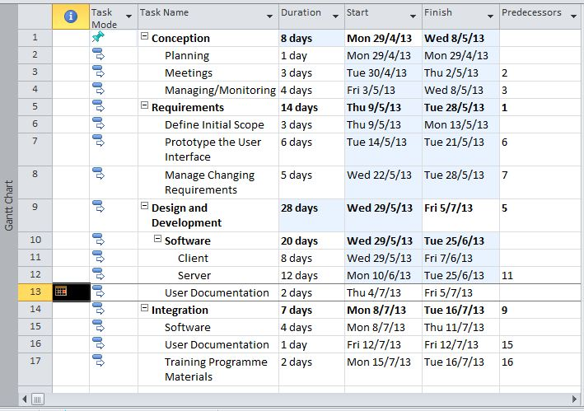
Project Schedule

Slide 31
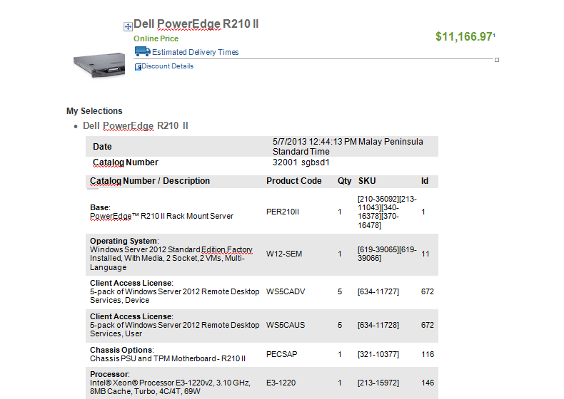

Slide 32
Project Plan – Risk Management
Risk Management
A) Exceeding the budget
B) Exceed allocated time schedule
C) Requirements of project change
D) Failure to deliver expected work

Slide 33
Project Plan – Risk Management
A) Exceeding the budget
Some strategies to prevent this
Renegotiate with the investors for a greater allowance or minimize cost in certain tasks by reworking them so as to allocate the resources saved to other tasks.
Risk Avoidance
Plan in detail and plan with consideration on how to solve the problems. Having the problems in mind while planning sets a motion which when thinking of ideas helps to think of solutions and when unnecessary ideas which could result in conflict are thought of they will not be given further thought but be thrown out. This save effort and allow them to concentrate on planning

Slide 34
Project Plan – Risk Management
B) Exceed allocated time schedule
Some strategies to prevent this:
Fast tracking
Working in parallel this allows several or more things to be done at a time. This allows the activities

Slide 35
Project Plan – Risk Management
C) Requirements of the project changes
Some strategies to resolve this:
Crashing
Allocating more resources to the project. Resources such as people to work on the project this however is costly. This creates the possibility to edit the project faster and make changes to the project which will satisfy the new requirements
If the new requirements prerequisites would make necessary our team to possess skill sets that our team lacks and it is far too late to make modifications or employ additional help.
Risk mitigation an action we can undertake is renegotiate
By renegotiating with the project owners we can offer substitutions and work out a solution without compromising quality

Slide 36
Project Plan – Risk Management
D) Failure to deliver expected work
If the work delivered is not up to expectations. Due to unforeseen circumstances. Such as the loss of project files or corruption of project files
Some strategies to prevent this
Plan Contingency
By having a Plan B having a backup of the saved project files on a thumb drive or hard drive, install an anti-virus to prevention corruption of project files we can obviate to be ready or prepared in case of the occurrence of scenarios which cause failure of the deliverables.

Slide 37
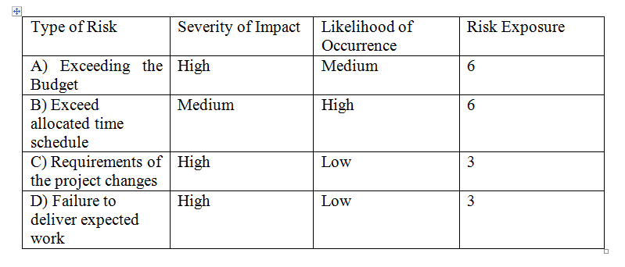
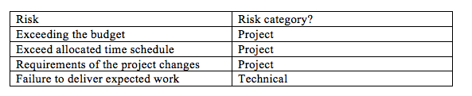
Project Plan – Risk Management

